Slide 1
All Saints Church proposal
1. designed for the altar to Face east
2. Parking will be developed in two phases
3. church will hold 1450 people based on 18.5 inch seating or
894 people based on 30 inch seating
4. overflow seating approximately 200
5. hall to hold 400 people and will have a divider to split it
6. 4 community meeting rooms with two being able to be split in half
7. also a choir room and children’s liturgy room that could be used for meetings
8. everything designed to on one floor except the mechanical rooms
9. gathering space designed for coffee after mass etc.
10. plan for non-commercial kitchen, but designed for catering and serving with a serving room built in the design
11. full sized vault for documents
12. outside garden area that could accommodate a columbarium in the future

Slide 2
S i t e P l a n

Slide 3
F l o o r p l a n

Slide 4
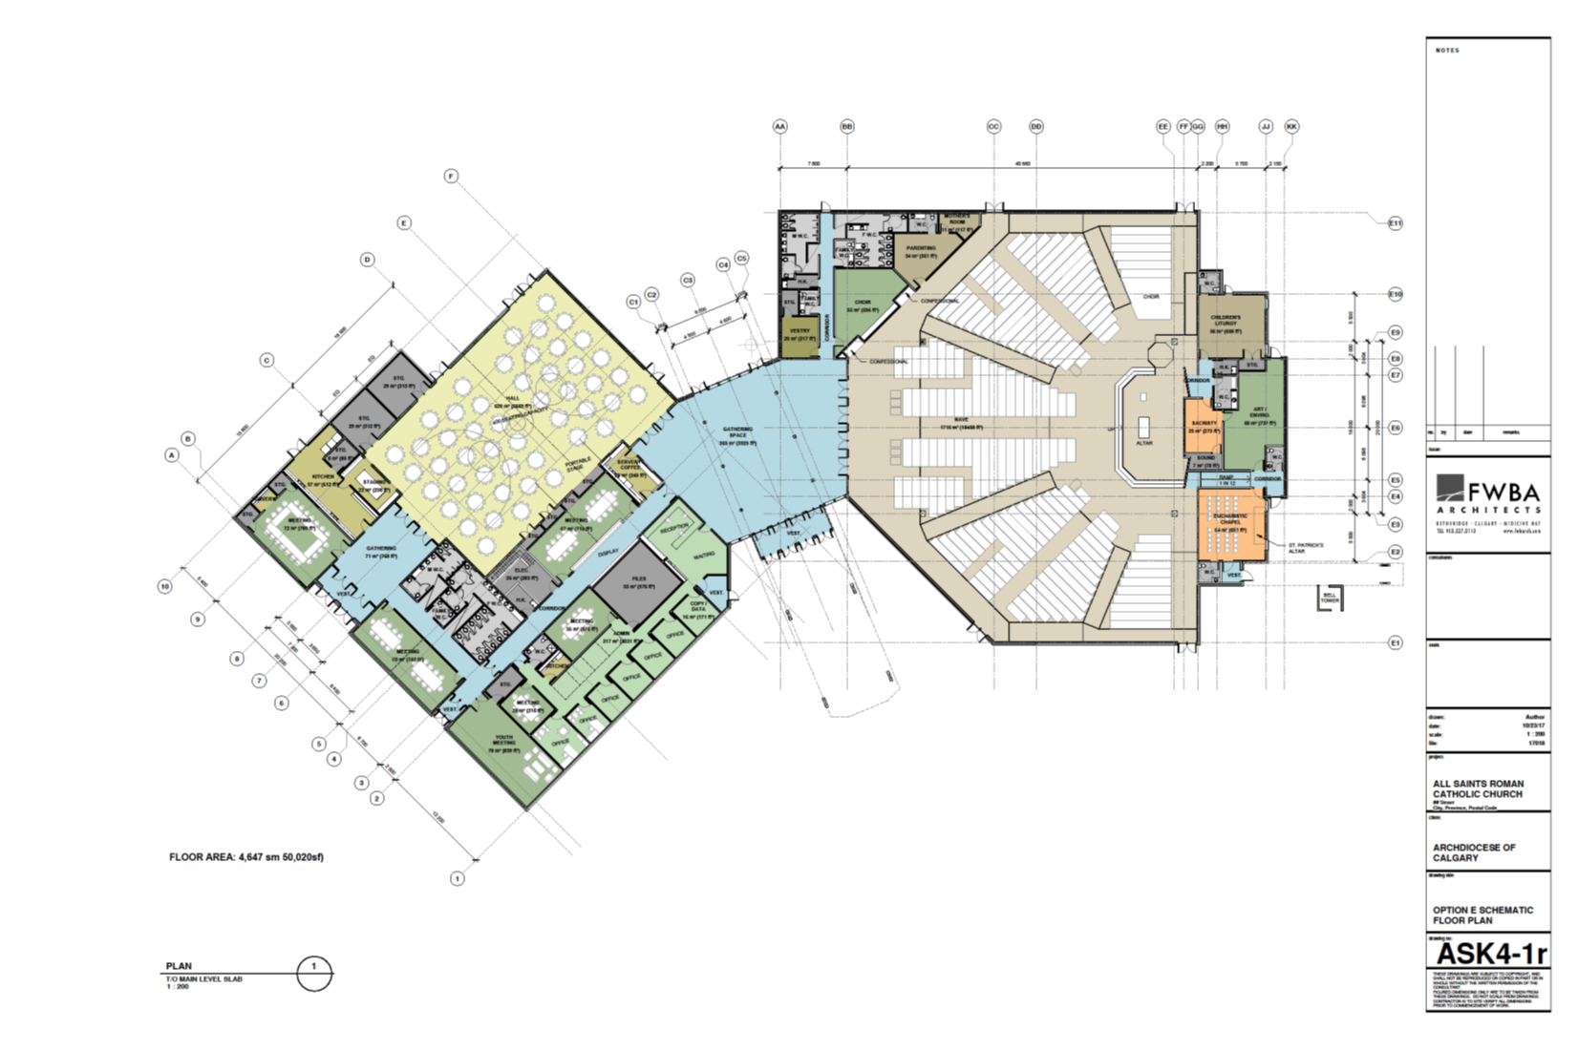

Slide 6
hall, meeting rooms and administration

Slide 7
Some 3D views
They have begun looking at where some stained glass could go

Slide 8
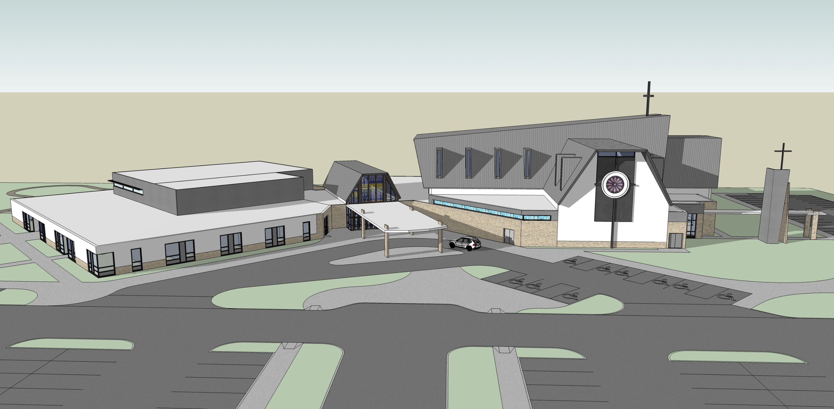
Looking north

Slide 9
Looking South east

Slide 10
Looking south west

Slide 11
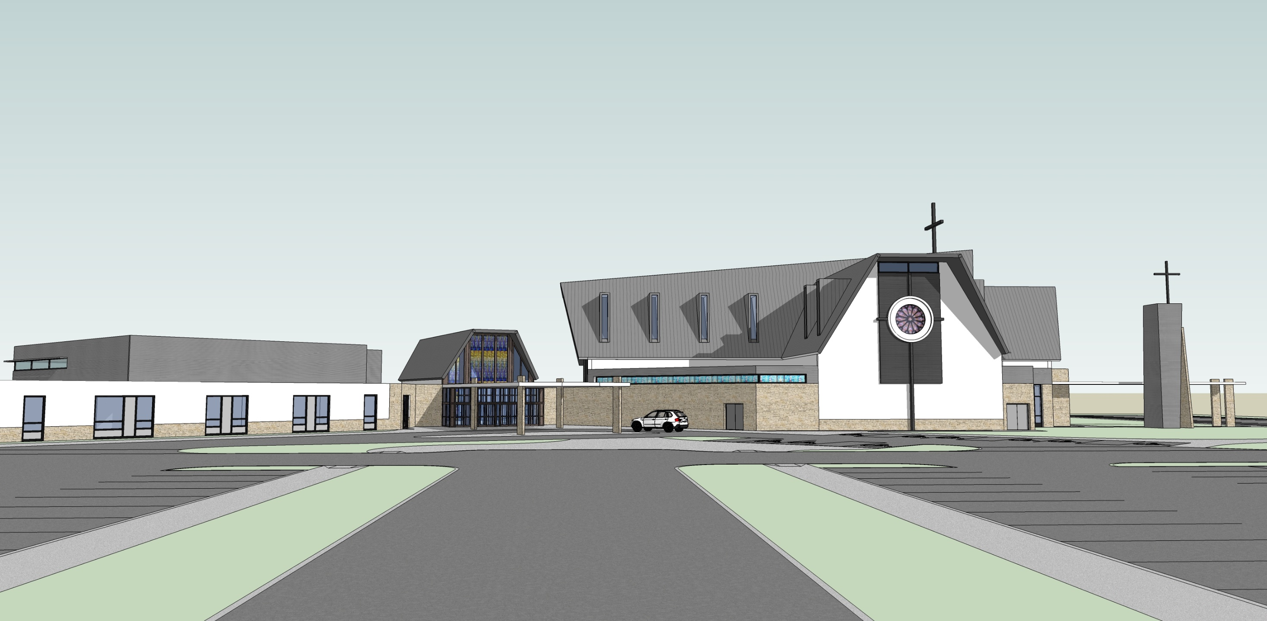
Ground level looking north

Slide 12
Ground level looking north east

Slide 13
K of C and CWL meeting rooms

Slide 14
Meeting room 1

Slide 15
Meeting room 2

Slide 16
Youth/social meeting room

